Slide 1

Real-time Virtual Drawing and Captions for Online learning using Computer Vision
Department of CSE (AI&ML)
DEPARTMENT OF COMPUTER SCIENCE AND ENGINEERING
Under the Guidance of
Dr. K. Durga Prasad
Professor & HOD,
CSE-AI&ML
TEAM MEMBERS:
22N71A6650 – G. Ramu
22N71A6648 – B. Rinka
22N71A6629 – Mohamadd Ajaz
22N71A6601 – Shivani

Slide 2
ABSTRACT
In today's evolving educational landscape, virtual classrooms demand innovative tools to enhance engagement and inclusivity. This project introduces a novel approach by integrating air-based drawing and live captioning to create a more interactive and accessible learning environment. Using Computer Vision for precise gesture recognition and hand tracking, supported by Mediapipe, the system enables instructors to draw in mid-air, with their movements captured and rendered in real-time onto a virtual canvas. Additionally, speech-to-text technology converts spoken content into live captions, ensuring inclusivity for individuals with hearing impairments or language barriers. By seamlessly combining visual and textual elements, this project enhances the clarity and effectiveness of online teaching, catering to diverse learning styles. Its versatile application extends beyond classrooms to collaborative learning environments and interactive e-learning platforms, paving the way for future innovations in digital education.
Keywords: Virtual Canvas, Live Captions, Computer Vision, Speech-to-Text technology, Hand Gestures Recognition.

Slide 3
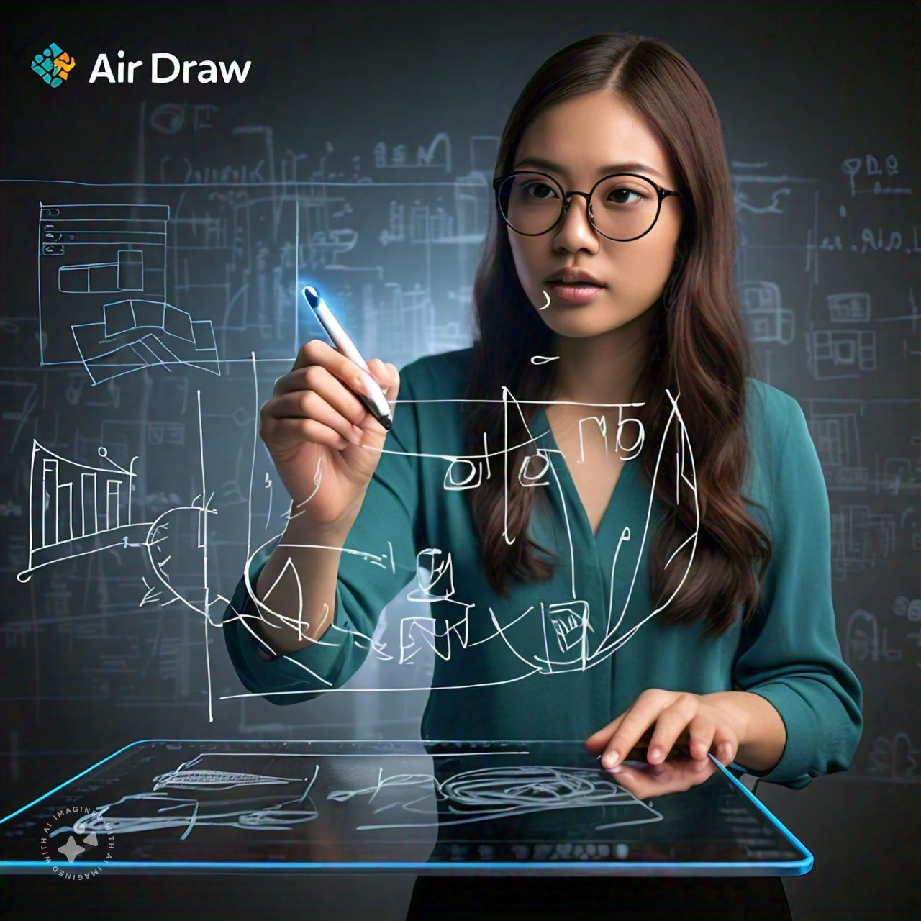
OBJECTIVES
Develop a Touchless Drawing System: Enable users to draw on a virtual canvas using hand gestures, eliminating the need for traditional input devices.
Implement Real-Time Hand Gesture Recognition: Use computer vision techniques to accurately detect and track hand movements and gestures in real-time.
Facilitate Multiple Drawing Modes: Provide functionality for switching between draw, erase, and move modes seamlessly.
Support Customization Options: Allow users to choose ink colors and save their drawings.
Create a Dual-Screen Interface: Display the live camera feed and the virtual canvas simultaneously for better user interaction and feedback.
Ensure User-Friendly Interaction: Design an intuitive and easy-to-use interface, including on-screen buttons for mode selection and exiting the application.

Slide 4
LITERATURE REVIEW
S. No | Year of Publication | Title of the Paper | Methods Used | Limitations
1 | 2022 | Virtual Canvas for Interactive learning using OpenCV | Object tracking using color detection, Frame reading and Canvas creation, Counter Detection, Shortcut keys for interaction. | Performance degradation in cluttered backgrounds. Dependency on Camera Quality. No Gesture Recognition.
2 | 2021 | On-Air Hand-Drawn Doodles for IoT Devices Authentication During COVID-19 | Dynamic Hand Air Gesture Recognition using CNN, Kalman filter, Background subtraction, Adaptive training with Artificial Images. | Ineffective in low light or dark conditions. Challenges with hand stability and for recognition. No proper erase, write modes to toggle.
3 | 2020 | Study on Hand Gesture Recognition by using Machine Learning | Glove based signal processing, Non contact gesture recognition, Appearance and Model based methods, K-NN and SVM machine learning models. | Complexity in algorithmic designs. Difficulty to recognise wide range of hand gestures. Real-time gestures faces a lot of delay.

Slide 5
LITERATURE REVIEW
S. No | Year of Publication | Title of the Paper | Methods Used | Limitations
4 | 2023 | Step by Step: A Gradual Approach for Dense Video Captioning | Video encoder, Temporal Event encoder and boundary classifier, Event proposal generation, Sentence Generation | Struggle to generalize videos. Dependency of quality of snippet segmentation. Large computation effort.
5 | 2018 | Design and Implementation of User Interface through Hand Movement tracking and Gesture Recognition | Sensor based click gesture recognition, Random forest machine learning algorithm, Data segmentation and feature extraction. | Hindered by processing delays. Limited Gesture types. Variability in the threshold of recognition system.
6 | 2017 | AirScript – Creating Documents in Air | 2-DifViz methods, GRU Networks, CNNs for visual representation as images, Myo- armband data collections. | Need of removing the reference surface. It is only limited to digits data and limited dataset taken. Relies on highly accurate hand movements capturing.

Slide 6
PROPOSED SOLUTION
Gesture Recognition: The system employs precise tracking of hand movements using advanced OpenCV and Mediapipe technology for accuracy.
Live Captions: Real-time conversion of spoken content into text captions enhances accessibility for all learners in the classroom using NLP.
Interactive Virtual Canvas: A dynamic and engaging interface allows for spontaneous teaching methods, improving concept illustration.
Mouse Click for Controlled Drawing: Introduce a feature that requires the user to hold down a mouse click while drawing in the air to prevent unintended drawing.
Standard Camera without Additional Sensors: Implement the model using a regular webcam, eliminating the need for specialized sensors.

Slide 7
REQUIREMENTS
HARDWARE
SOFTWARE
Computer/Processor: A computer with a decent processor (minimum Intel i5) for smooth execution.
Webcam: A high-definition camera (720p or 1080p) to capture hand movements clearly for gesture recognition.
Microphone: A microphone to capture speech for the speech-to-text functionality.
Graphics Card: A Computer with integrated graphics card can suffice for basic operations.
RAM: Minimum of 8 GB RAM for running the software and handling multiple processes.
Operating System: Windows or macOS
Programming Languages: Python 3.x
Libraries:
OpenCV
Mediapipe
NumPy
SpeechRecognition
Threading
4. IDE: VS Code or Jupyter Notebook

Slide 8
REQUIREMENTS
FUNCTIONAL
NON-FUNCTIONAL
Hand Gesture Detection: The system should detect hand landmarks and recognize gestures like drawing, erasing, and button interactions.
Drawing on Canvas: Users should be able to draw on a virtual canvas using hand gestures.
Color Selection and Erasing: The system should allow users to change the brush color with on-screen color buttons and users should be able to erase.
Live Video Feed: The application should display a live feed from the webcam alongside the drawing canvas.
Save Drawing: Users should be able to save their drawing by pressing a designated key.
Real-Time Performance: The system should process hand gestures and voice with minimal latency.
Accuracy: Gesture recognition and speech-to-text conversion should maintain a high level of accuracy for reliable operation.
Compatibility: The application should run smoothly on systems with moderate hardware configurations and standard webcams.
Robustness: The system should handle errors gracefully, such as unclear gestures.
Security: The application should securely handle user data, ensuring no unnecessary access to the webcam or microphone.

Slide 9
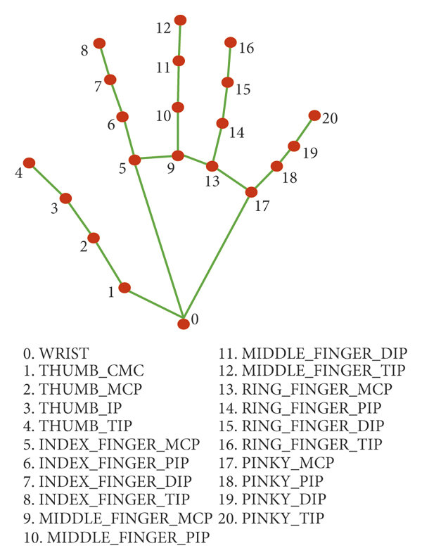
ALGORITHMS/ TECHNIQUES USED
Hand Tracking and Recognition using Mediapipe
Mediapipe is a cross-platform framework developed by Google that specializes in real-time computer vision tasks. In this project, the Hands module from Mediapipe is utilized for hand detection and tracking. It identifies key landmarks on the hand, such as the tips of the fingers, and tracks their movement in real time. These landmarks are used to interpret gestures, such as drawing and selecting buttons on the screen.
The high accuracy and low latency of Mediapipe's hand tracking make it an ideal choice for interactive applications like this. Mediapipe’s hand tracking significantly enhances the interactivity of the air-drawing project by enabling accurate and real-time gesture recognition.

Slide 10
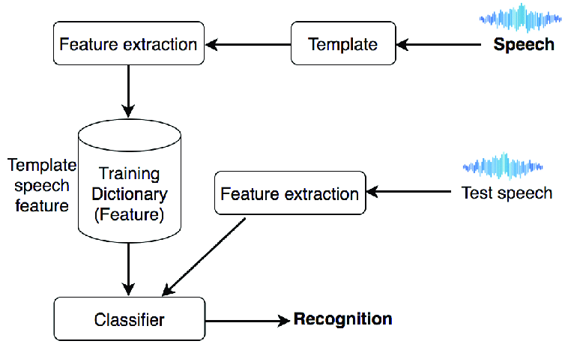
ALGORITHMS/ TECHNIQUES USED
2. Speech Recognition for Real-time Closed Captions
Speech recognition technology in this project is implemented using the speech_recognition library, which leverages Google's speech-to-text API. The microphone continuously captures audio, and the system processes it to convert speech into text.
This functionality allows the user to give voice commands, which are then displayed as captions on the screen. It runs on a separate thread, ensuring that the main drawing interface remains responsive while constantly updating captions. Speech recognition adds an interactive, hands-free element to the air-drawing experience.

Slide 11
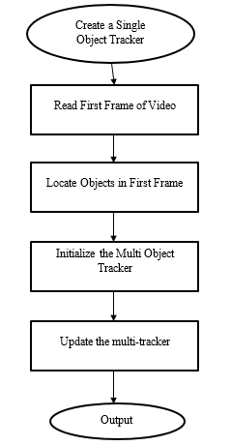
ALGORITHMS/ TECHNIQUES USED
3. OpenCV for Real-time Video Processing
OpenCV (Open-Source Computer Vision Library) is used for real-time image processing in your project. It handles tasks such as capturing video from the webcam, displaying the camera feed, and drawing shapes on the canvas. OpenCV allows you to overlay the drawing on the camera feed, create interactive buttons for color selection, and implement features like erasing the canvas.
The library also handles GUI-related tasks such as resizing windows, displaying text, and managing user inputs, making it essential for both the visual and functional aspects of the project.

Slide 12
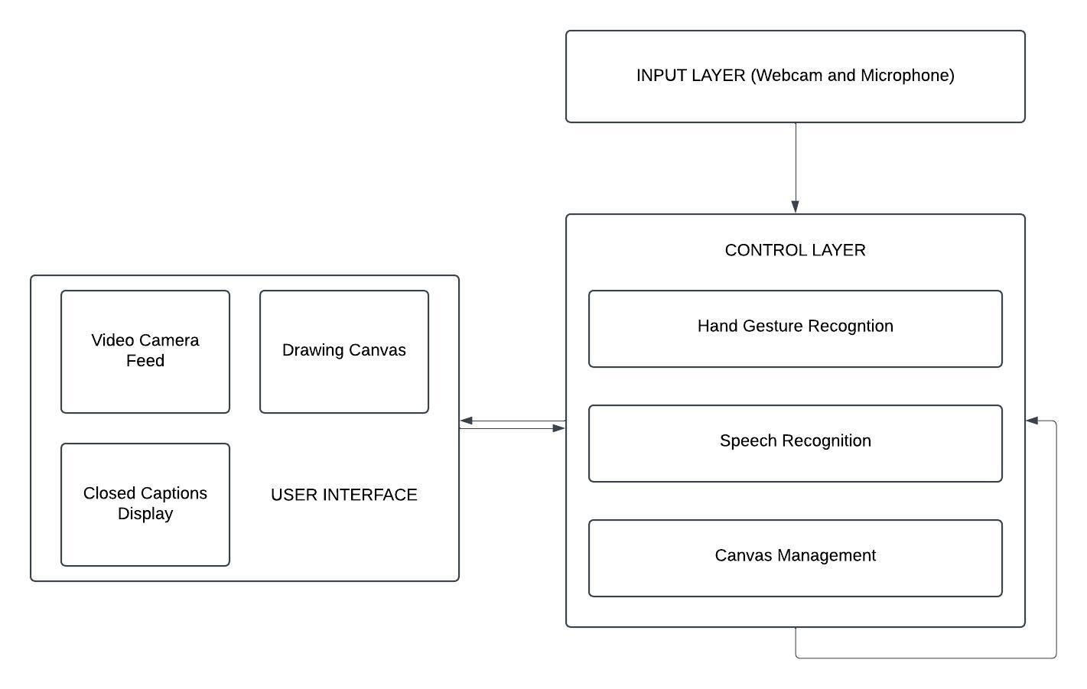
SYSTEM ARCHITECTURE

Slide 13
Conclusion & Future Work
In conclusion, this air-drawing application integrates a hand gesture recognizer, speech-to-text converter, and drawing canvas to provide users with a truly unique and engaging experience. A user can input drawings in real-time using hand gestures while, at the same time, capturing captions based on voice inputs.
The application provides an innovative solution for interactive presentations, online education, creative design, and other use cases requiring hands-free drawing and captioning. Its intuitive interface and smooth performance make it accessible to users with varying technical expertise, enhancing its versatility and scope.

Slide 14
THANK YOU

